Slide 1
Corporate Strategy & Internal Audit
Division Meeting

Slide 2
Division Performance Summary

Slide 3
Progress Activity Plan
Data Science & Data Center
Cdd. Department Head : will join soon
Infrastructure : Progress Proof of Concept - AWS
Data Completion Sales Key Account : Dec 100%, Jan 52%
New Report Automation : Daily Sales & Accum Online Channel
Target Sales Operation per Month & per Days
Sales Incentives
Sales Reporting Mitrelindo
Office Strategy Management
Cdd. Department Head : Done
Planning Cycle : Rakornas done
Business Process : AX & HRM
Continues Improvement : Program Plan
Internal Audit
Follow up Selisih Stock Opname : Monitoring Report https://megaperintis.co.id/MonitoringSO
Stock Opname Internships : Jakarta
Cut off Inventory : MP done, MG done, MPG Nov & Dec done
ERP – AX : Migrasi Data

Slide 4
On Going Report/Analysis Development
Report Stock and Sales Online 8com
Adding GP on Accumulation Data
Adding VS LM, VS LY on Daily
Optimize Database for Salethru
Fixing Formatting in DM Meeting Data
Optimize Database Stock and Sales for SaleThru
Checking Output Report vs Database all of report (Weekly)

Slide 5
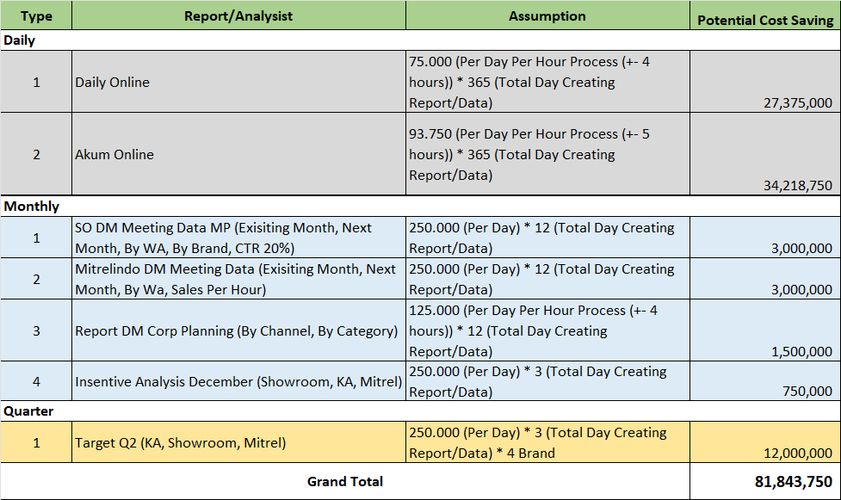
Potential Cost Saving

Slide 6
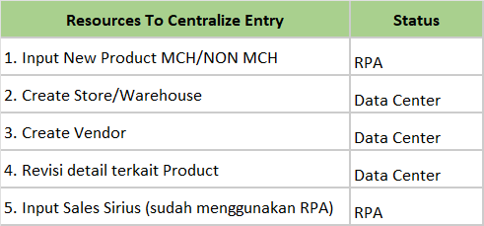
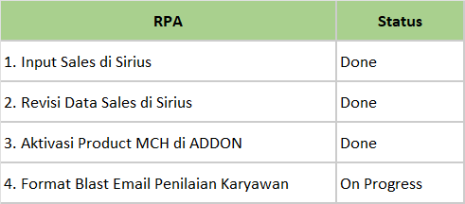
RPA & Data Entry
Asumsi Biaya per hari : 150rb
Input 276 hari @ 4 jam
Potential Cost Saving 20.7jt

